Slide 1
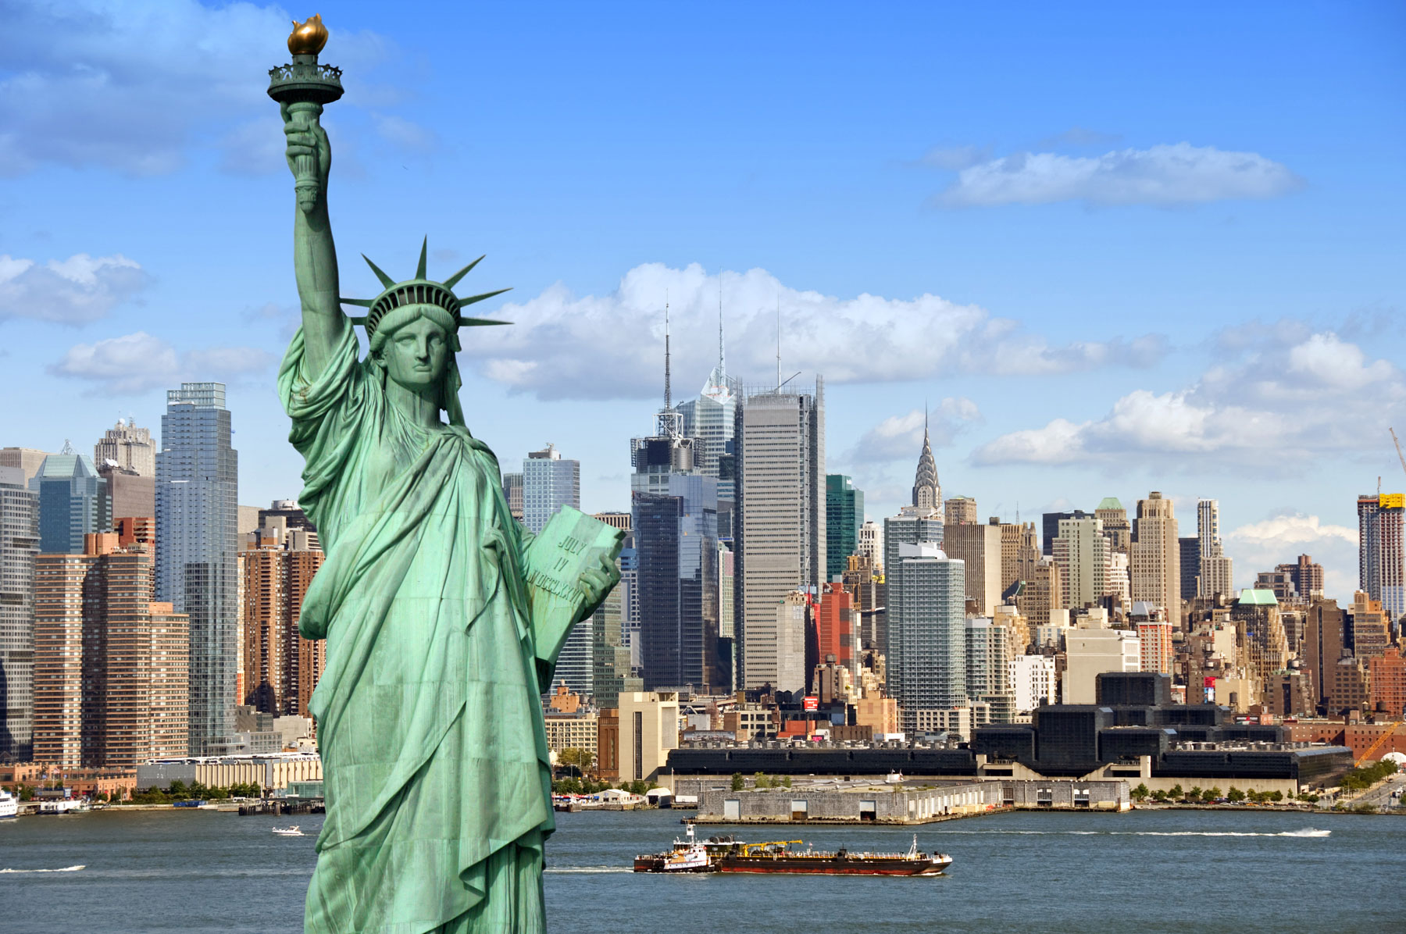
New York

Slide 2
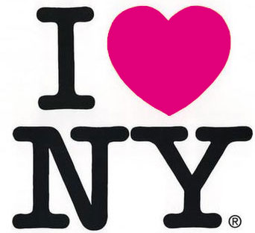
Content:
A little bit of history…
Things you should know…
Places you have to visit…
Don‘t leave without trying…

Slide 3
History
10,000 BC – first Native Americans arrived
1524 – The French discovered New York
1609 – First Dutch immigrants arrived
1626 – The Dutch named the island New Amsterdam
1664 – England took New Amsterdam from the Dutch and renaimed New York

Slide 4
Important Facts
Population: 8,2 millions
Immigrants from over 180 countries live there
New York City is a center for media, culture, food, fashion, art, research, finance, and trade

Slide 5
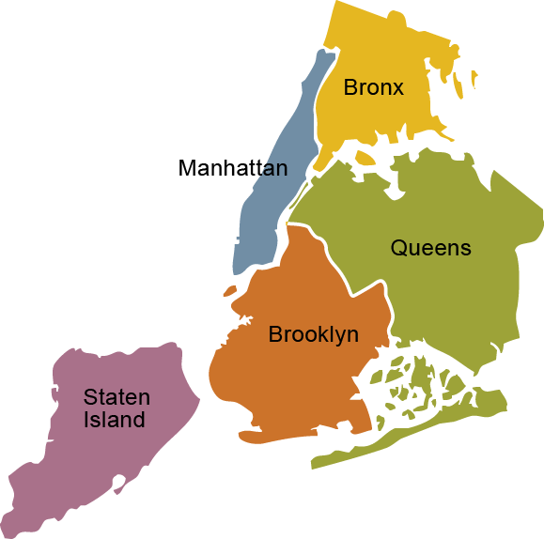
The five boroughs are:
- Manhattan
- Brooklyn
- Queens
- The Bronx
- Staten Island

Slide 6
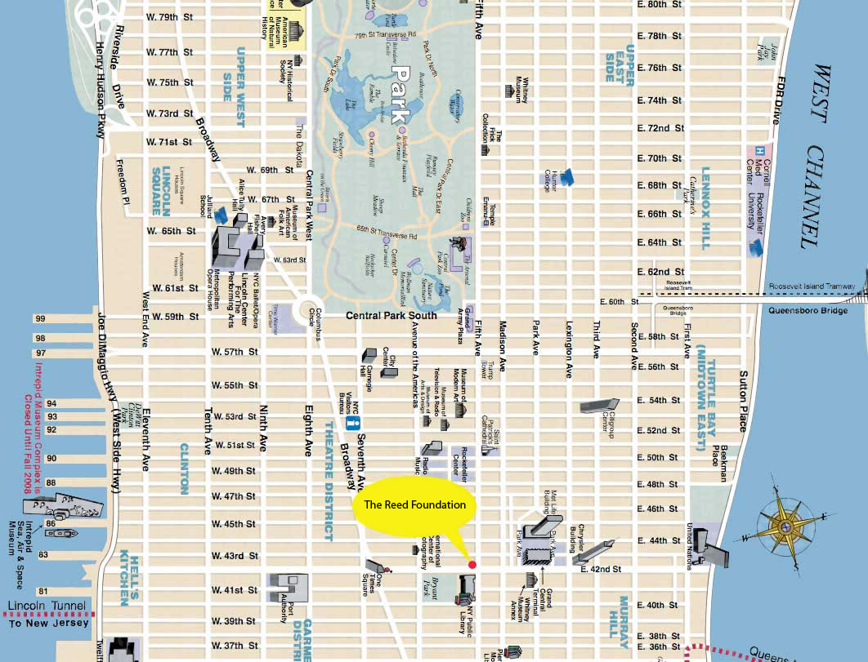
The streets don‘t have names, they only have numbers and they have a square form.

Slide 7
Places you have to visit:
Central Park
Empire State Building
Brooklyn Bridge
Statue of Liberty
Wall Street
Fifth Avenue
Times Square and Broadway
Ground Zero Memorial
NYC Museums

Slide 8
Central Park
Is located in the heart of Manhattan and it is one of the world’s largest parks.
It is also called “The Green Lung of New York”
Until 1873 it was a dirty forest called Jones Wood and ca. 1500 immigrants lived there

Slide 9
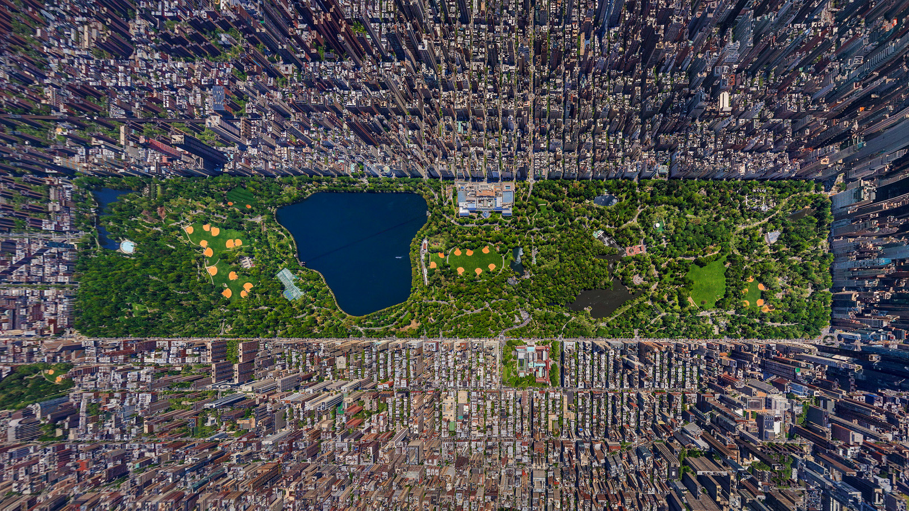

Slide 10
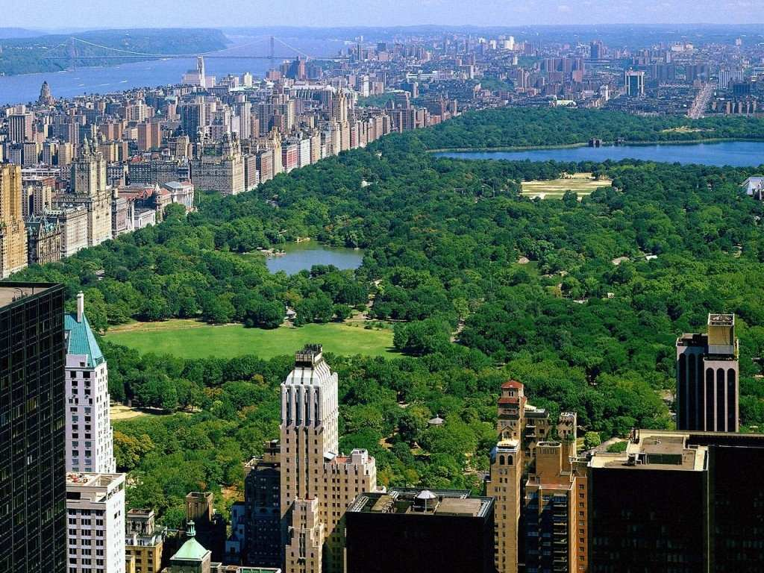
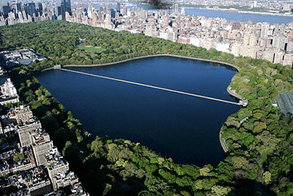

Slide 11
Empire State Building
This skyscraper has 102 floors and is 443 metres high.
It stood as the world's tallest building for 40 years, from 1931 until construction of the World Trade Center's in 1972.
It is now the 23rd-tallest building in the world.
It is possible to go to the top of the bulding.
Prices: Adults 21 dollars and Childrens 14 dollars

Slide 12
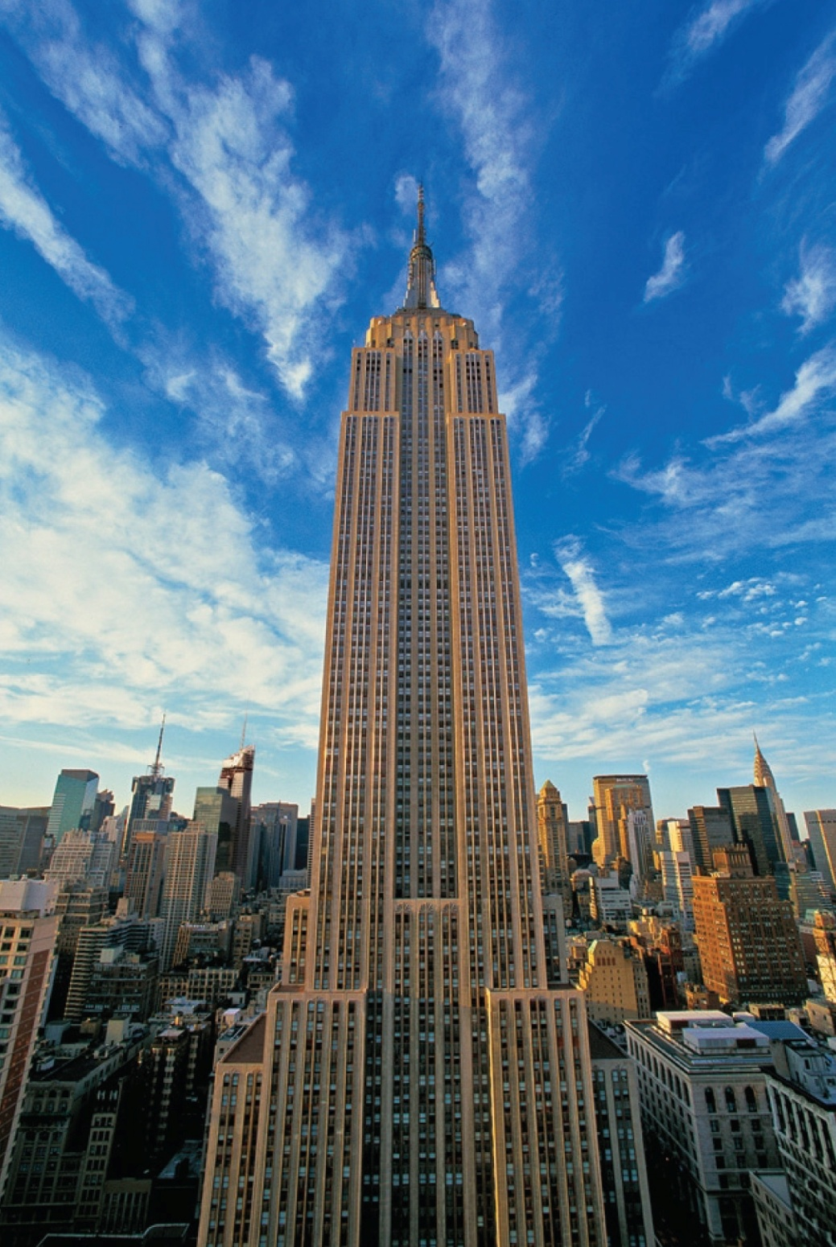

Slide 13
Brooklyn Bridge
Was the world's longest suspension bridge and was built in 1883.
The bridge has been featured in countless movies and television shows.
Was the first land passage between Manhattan and Brooklyn.

Slide 14
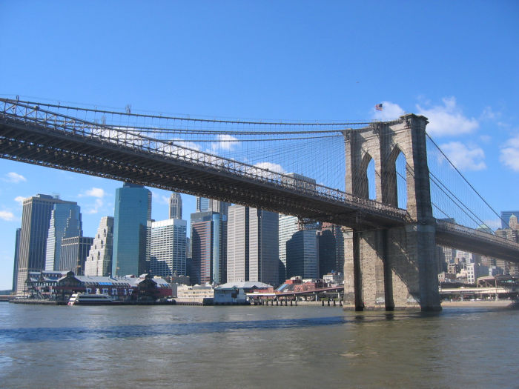

Slide 15
Statue of Liberty
The Statue of Liberty is New York City's most famous landmark.
It was a gift from the French, given in 1886, celebrating the American Declaration of Independence that happened on 4th July 1776.
It is a symbol of freedom, independence and hope.

Slide 16
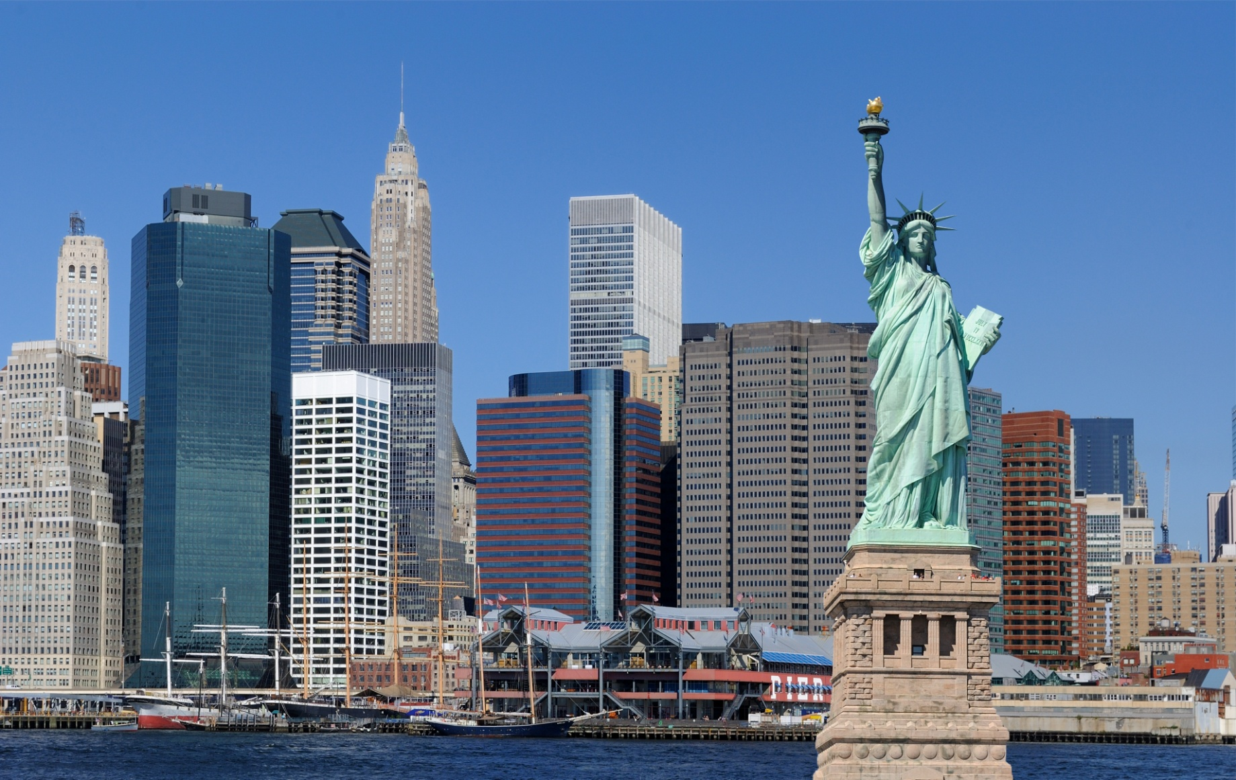

Slide 17
Wall Street
On this street there are the biggest stock markets of the whole world.
There are also many banks from all over the world.

Slide 18
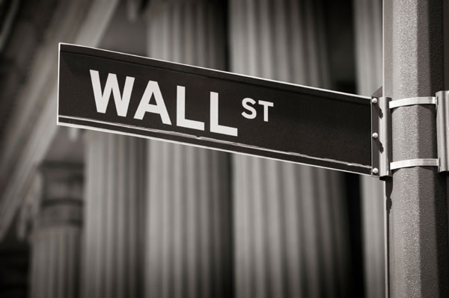
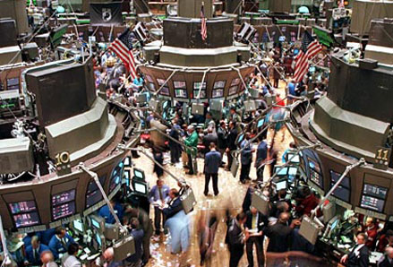

Slide 19
Fifth Avenue
It is one of the most famous streets of the world.
It is also the most expensive street in the world.
Around it, are a lot of famous sights of New York.

Slide 20
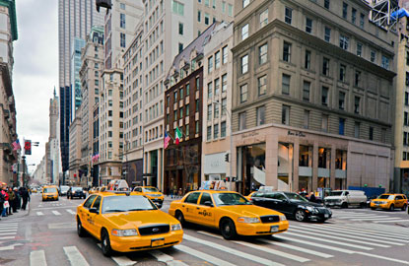
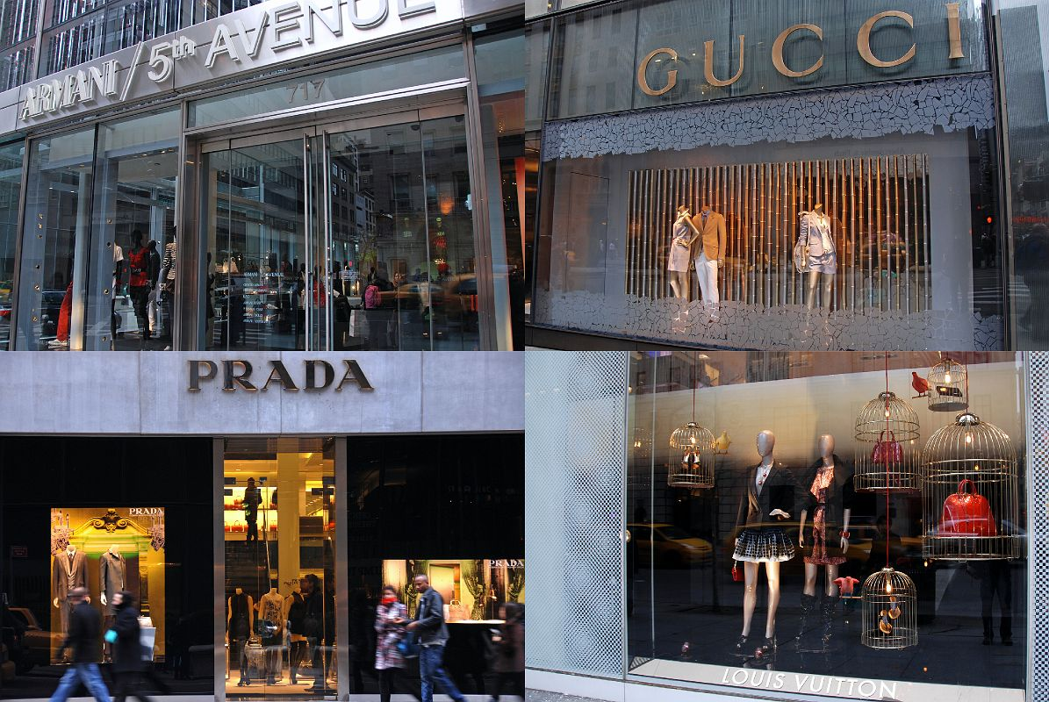

Slide 21
Times Square and Broadway
The name comes from the famous newspaper „New York Times“
Is the world's most visited tourist attraction, hosting over 39 million visitors annually.
It is famous because of its bright lights and crazy advertising.
Broadway is the longest street of New York with 20km and cuts two other streets
Broadway is also famous because of its musicals.

Slide 22
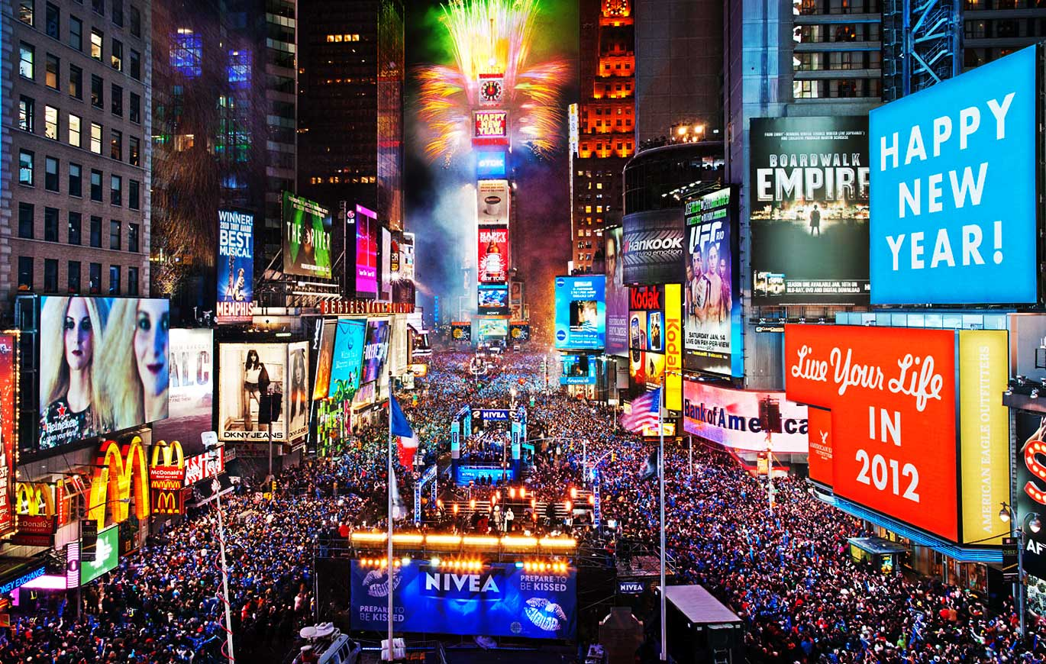

Slide 23
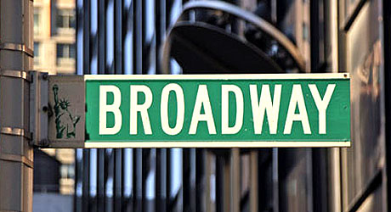
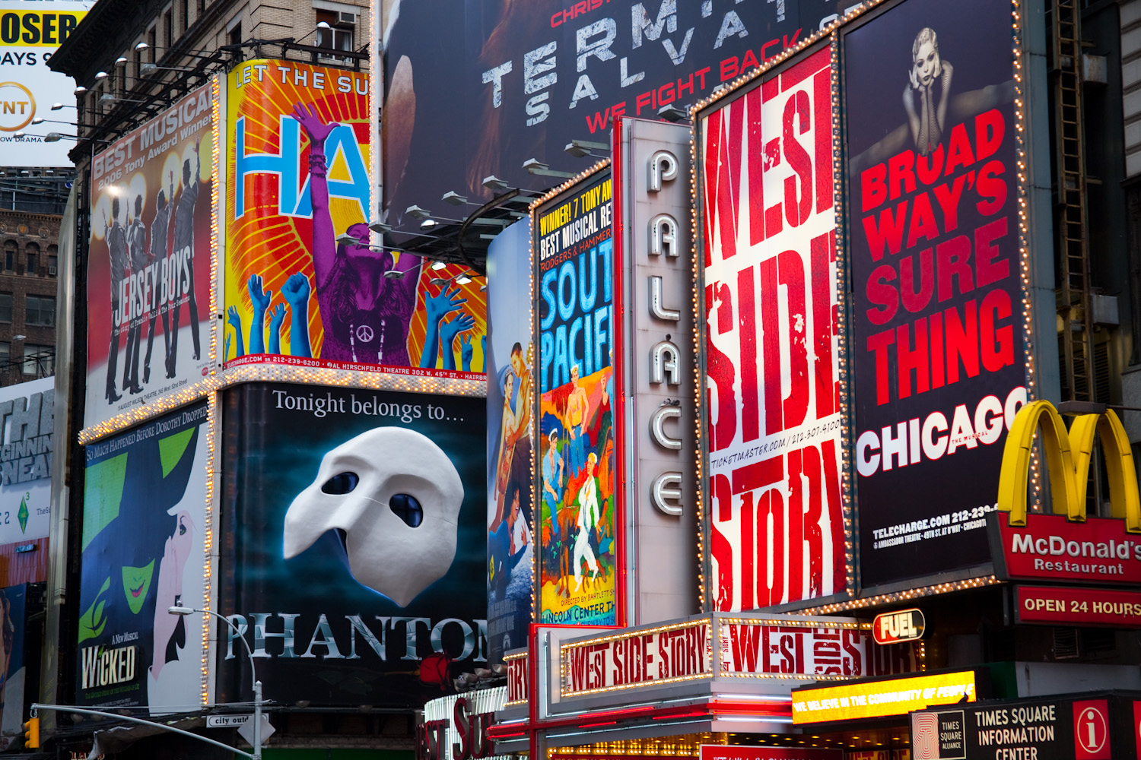

Slide 24
Ground Zero Memorial
The memorial honors the nearly 3,000 people who died in the attacks on September 11, 2001 (including those who were killed in Pennsylvania and at The Pentagon).
The names of the men, women and children who lost their lives are inscribed all over the monument.
There is also a museum telling the history of this event

Slide 25
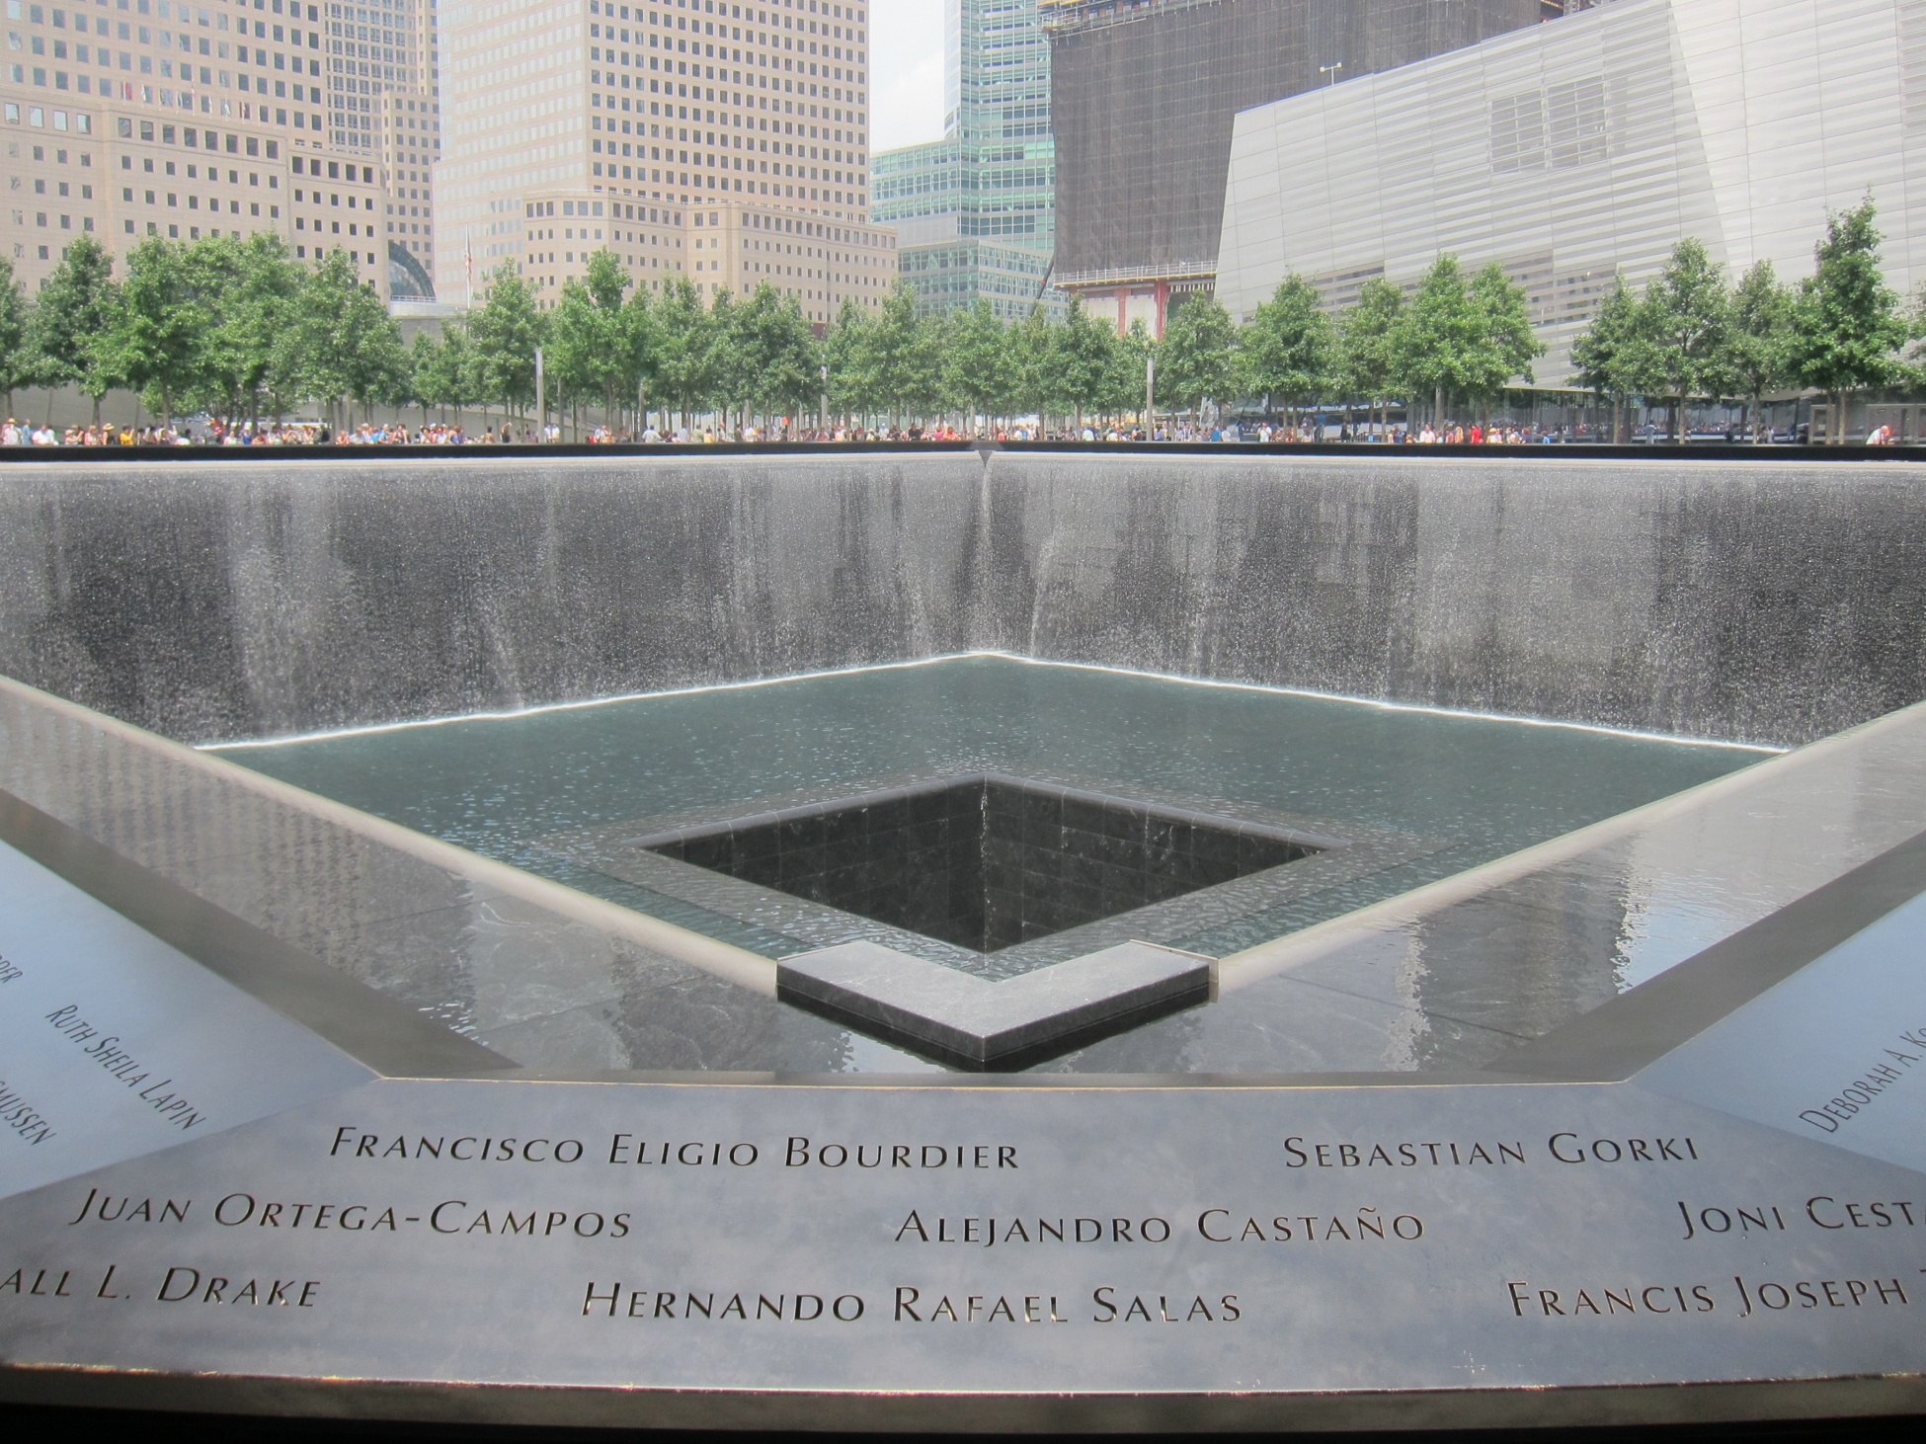

Slide 26
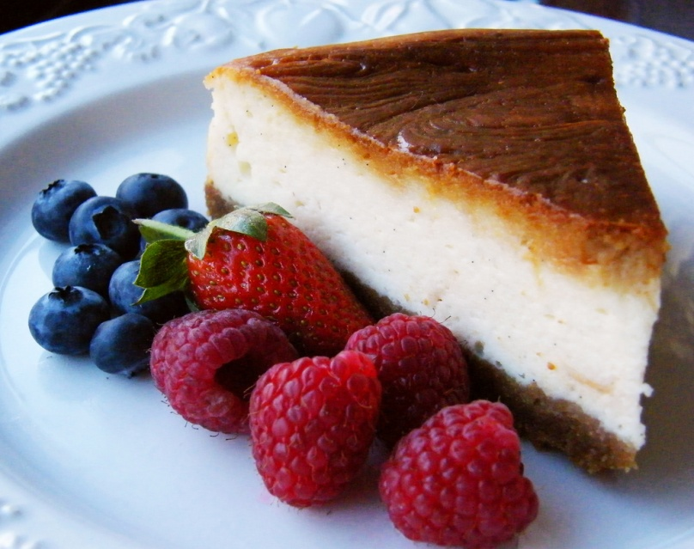
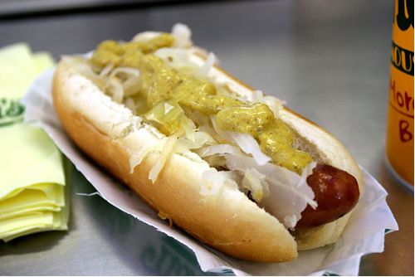
Don‘t leave without trying:
The New York Bagel
The New York Hot Dog
The New York Pizza
The New York Cheesecake

Slide 27
Quiz Time!

Slide 28
What was the first name of New York?
New Amsterdam

Slide 29
What is Wall Street?
A street with a lot of banks and stock markets.

Slide 30
How many people live in New York?
Ca 8,2 millions

Slide 31
How many boroughs are there and what are their names?
The five boroughs are:
- Manhattan
- Brooklyn
- Queens
- The Bronx
- Staten Island

Slide 32
What was the first name of Central Park?
Jones Wood

Slide 33
Which places does the Brooklyn Bridge conects?
Manhattan and Brooklyn

Slide 34
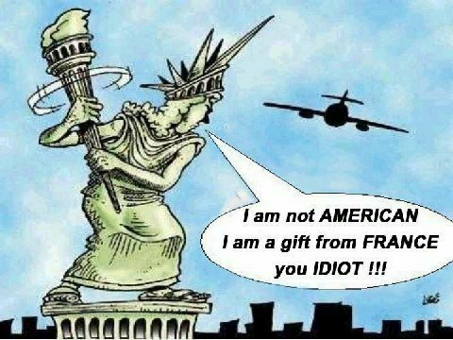
From which country does the Statue of Liberty comes?
France

Slide 35
Which is the longest street of NYC?
Broadway Street.

Slide 36
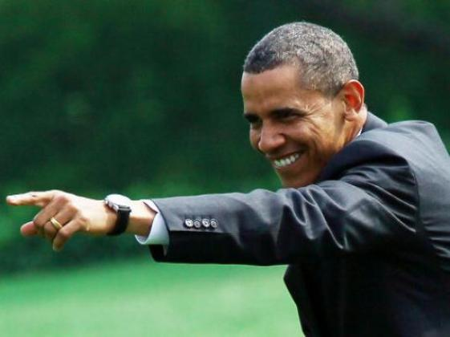
New York is waiting for YOU!

